Slide 1
Air Masses

Slide 2
Humidity
The relative measure of the amount of water vapor in the air
Psychrometer
Water vapor affects the density of the air.
Cold air is heavier than warm air.

Slide 3
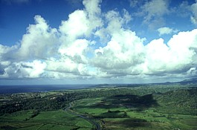
Air Masses
Notes:
http://www.srh.noaa.gov/crp/?n=education-heattransfer

Slide 4
What is an air mass?
A body of air that has the same temperature and humidity throughout

Slide 5
How do air masses form?
If a large body of air sits over an area of land or water for a long period of time, it will take on the characteristics of the land or water beneath it.
Temperature
Humidity

Slide 6
Location, Location, Location…
Air masses over the equator will have higher temperatures.
Air masses over polar regions will have lower temperatures.
Air masses over water (maritime) will have high humidity (moisture content).
Air masses over land (continental) will have low humidity (moisture content).

Slide 7
Where do air masses form?
Air masses tend to form in areas with little wind.
Remember, they sit over an area for a long period of time without moving.

Slide 8
Labeling Air Masses
Air masses that form over water are called maritime.
Air masses that form over land are called continental.

Slide 9
Classification of Air Masses
mT – maritime tropical
cT – continental tropical
mP – maritime polar
cP – continental polar
cA – continental arctic

Slide 10
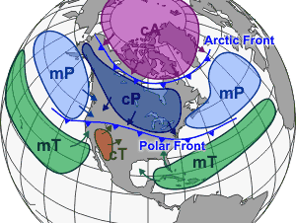
Location of Air Masses
Notes:
http://www.srh.noaa.gov/crp/?n=education-airmasses

Slide 11
Characteristics of Air Masses
mT – warm, moist air
cT – warm, dry air
mP – cold, moist air
cP – cold, dry air
cA – super cold, dry air

Slide 12
How do air masses move?
Convection!
Notes:
http://commons.wikimedia.org/wiki/File:Convection.gif

Slide 13
Convection
Warm air rises, and cold air moves in to replace it.
A circulation pattern is formed.
Convection causes air to move and ocean currents to form.

Slide 14
How does convection work?
Density!
Warm air is less dense and rises.
Cool air is denser and sinks.

Slide 15
How does convection work?
Air Pressure!
Temperature differences cause air pressure differences.
Warm, less dense air has lower pressure and rises.
Cool, denser air has higher pressure and sinks.

Slide 16
Reflection Question
How do different air masses form?

